Slide 3
SharePoint Framework
Radovan Ostojić
Comtrade SE

Slide 4
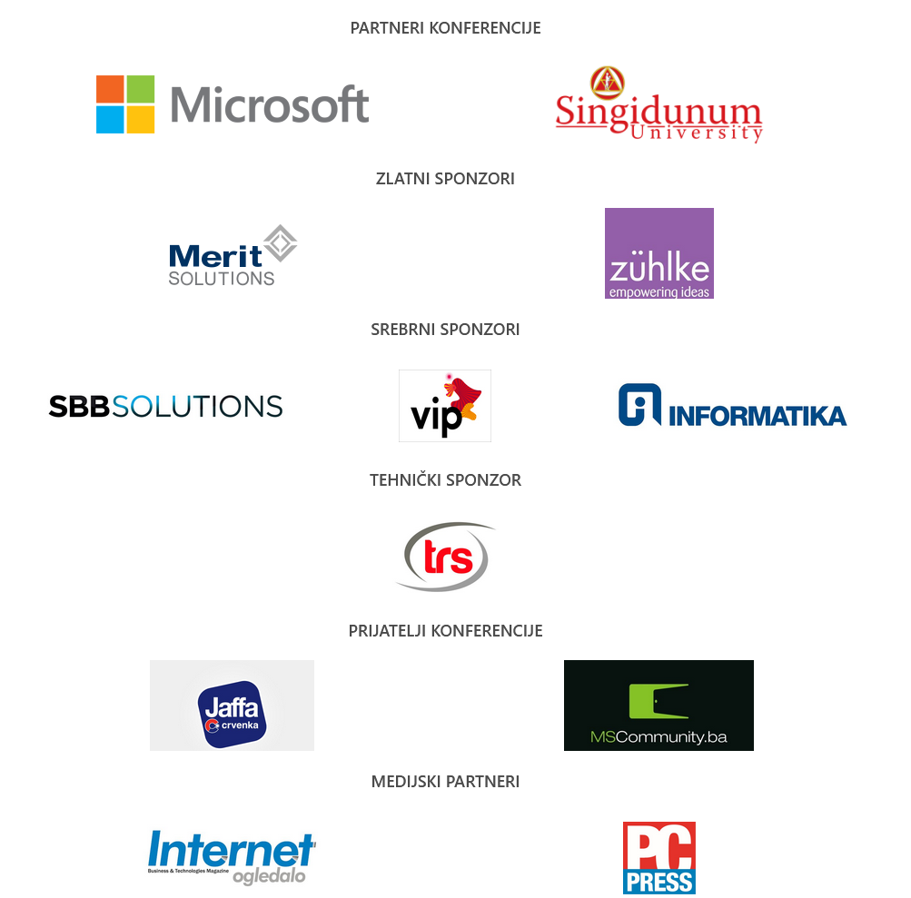
Sponzori

Slide 5
O predavaču
Programer i software arhitekt, sa specijalizacijom SharePoint i .Net.
Zaposlen u Comtrade SE kao Lead inženjer
Trenutni klijent Vanderlande iz Holandije, radim kao Sistem arhitekt u oblasti warehouse automation-a.

Slide 6
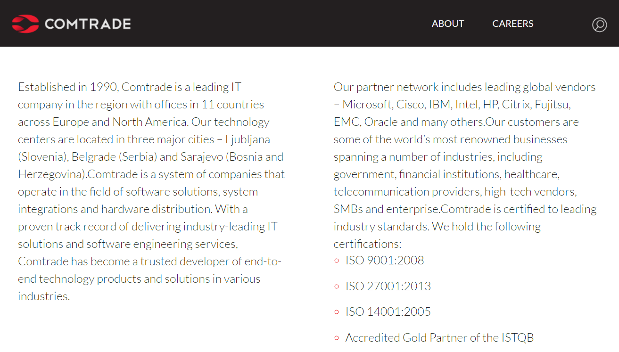

Slide 7
Agenda
Uvod (uz malo istorije ☺)
Prethodnici: Farm Solution, App/Add in model
SharePoint Framework
Demo

Slide 8
Uvod u SharePoint Framework

Slide 9
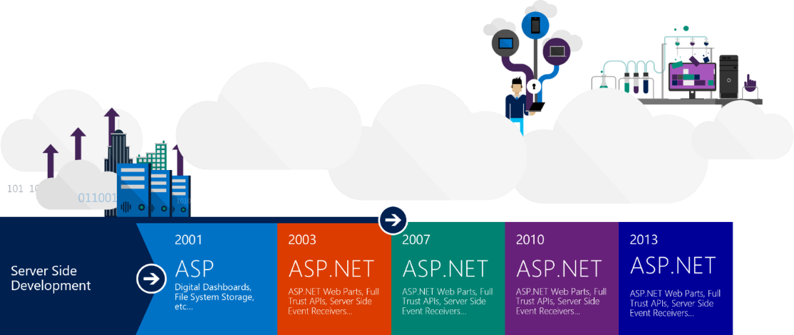
Server side development – ko se seća?
Notes:
SharePoint started as an on-premise product back in 2001. It picked up a lot of users along the way, and a large developer community to extend and shape it in ways that we couldn’t foresee. For the most part, the extensibility that customers did followed the same patterns and practices that the developers inside the team used. Things like web parts, SharePoint feature XML, etc. were all the same, and a large majority of the features were written in C#, compiled to DLLs, and deployed to the servers.
While that solution works well in an environment with only one enterprise, it doesn’t work and scale in the cloud, where multiple tenants all run side-by-side. Because of this, traditional extensibility models don’t work, and alternate methods were introduced. Two popular ways of customizing SharePoint are through client-side JavaScript injection and the SharePoint add-in model. Both of these solutions have pros and cons. Let’s start with script injection.

Slide 10
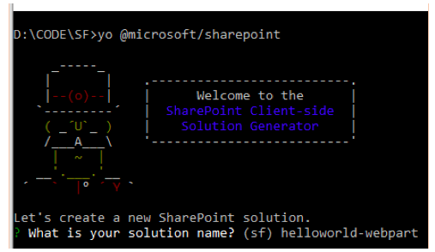
Provides full support for client-side customization
Notes:
The purpose of the SharePoint Framework to make client-side customizations an official development model for SharePoint developers.
Developers are able to create client-side customizations that are packaged and deployed to SharePoint sites just like SharePoint solutions and SharePoint add-ins were in previous versions.

Slide 11
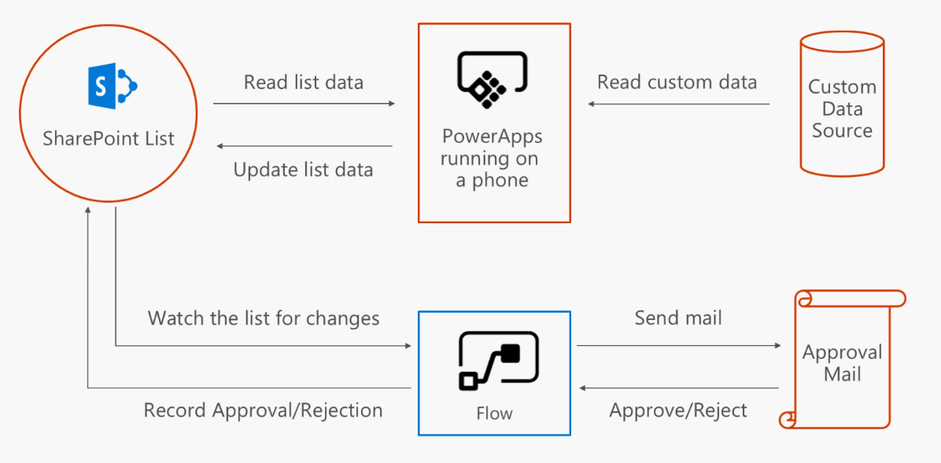
Provides easy access to SharePoint data
Notes:
These customizations will also have easy access to SharePoint data using APIs included with the SharePoint Framework. But this does not mean they will be limited to accessing just SharePoint data… they are client-side solutions that can use any technology to access other data sources, including the Microsoft Graph, Office Graph or other accessible APIs.

Slide 12
Customizations run in current context
Components built using the SharePoint Framework will run in the current context, unlike their predecessor add-ins that ran within the context of an IFRAME. This means not only will they load faster, but they will run within the context of the current user and using the current connection in the browser.
SharePoint Framework customizations are also rendered in the current page DOM, again not in an IFRAME, which eliminates the requirement (but not the ability) to host more involved customizations in another website.

Slide 13
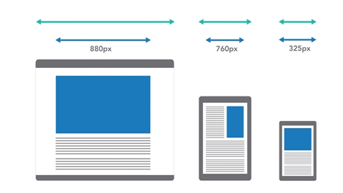
Customizations responsive & accessible
Because the customizations are rendered in the current page DOM and not in an IFRAME, they will not have the same baggage associated with them as IFRAMES have. One of the biggest benefits to this is that the customizations will be responsive and accessible by nature.

Slide 14
Development experience embraces web development stack
Significant break from the past
Traditional SharePoint developers are used to using tools like Visual Studio to create SharePoint solutions or add-ins.
This approach opens the platform up to more developers because it is not limited to Windows; the tools are cross platform. You can use any text editor you prefer. Popular open source tools are used to solve different parts of the build toolchain from project scaffolding, building, serving, packaging all the way to deploying. This includes tools like Yeoman, gulp and webpack, runtimes like Node.js, package managers like NPM and editors like Visual Studio Code or Sublime.

Slide 15
First Party & Third Party
Microsoft vs Others

Slide 16
Kratak prikaz
Prethodnici:
Farm Solution /
App / Add in model

Slide 17
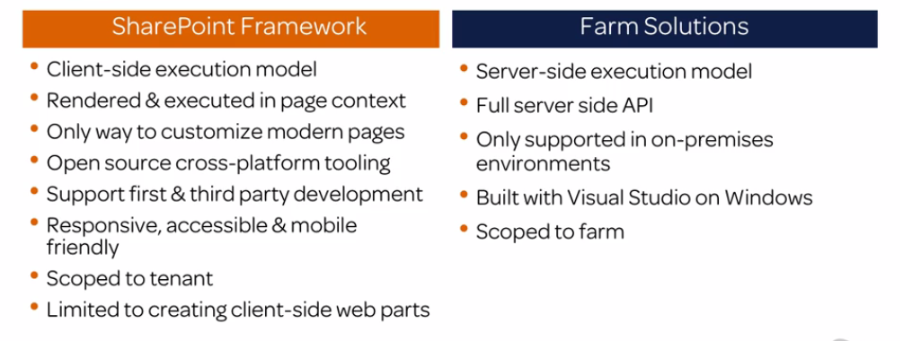
SpFx vs Farm Solutions

Slide 18
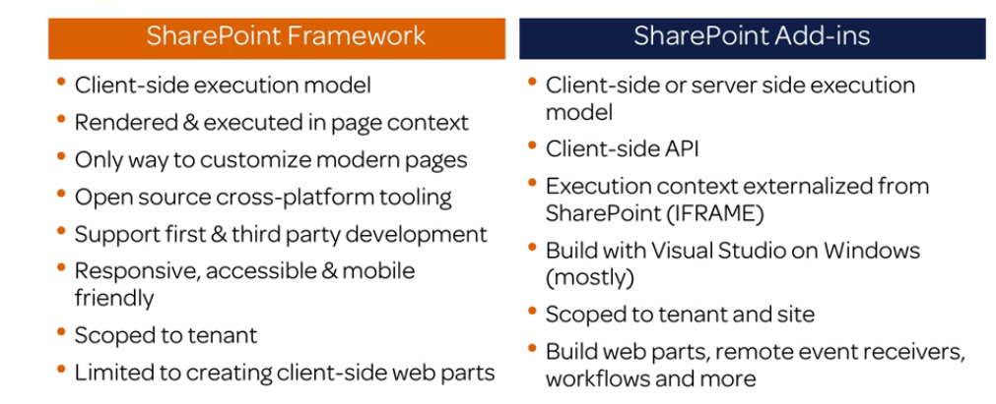
SpFx vs SharePoint Add-ins

Slide 19
SharePoint Framework

Slide 20
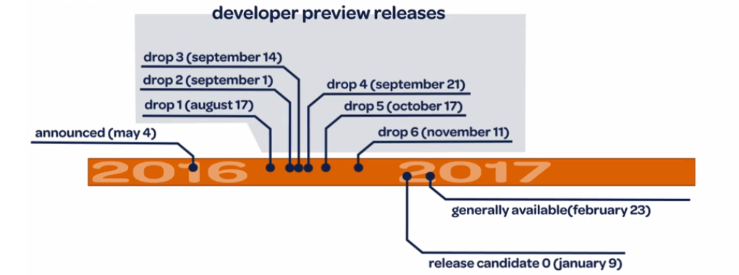
SharePoint Framework Timeline & Roadmap

Slide 21
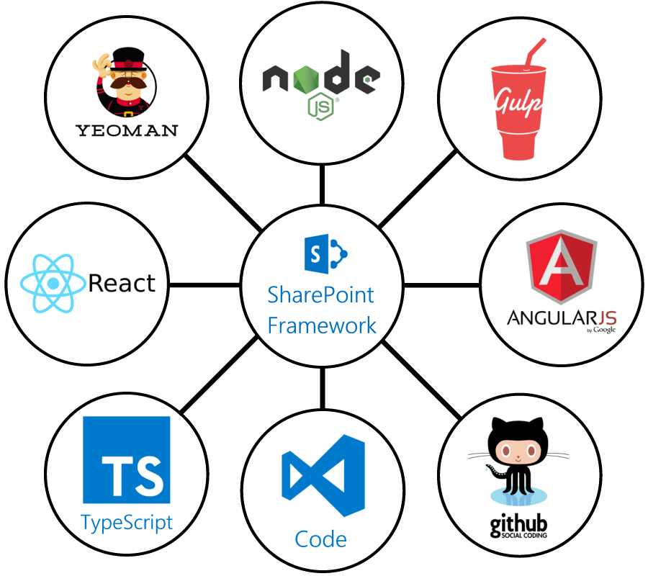
Are you ready?

Slide 22




Web stack tooling compared to classic MS tools
IIS Express
MS Build
VS Project →
New → <Template>
C#

Slide 23
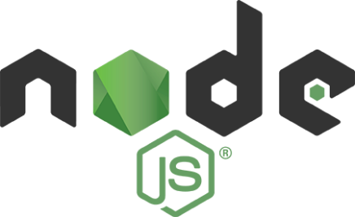

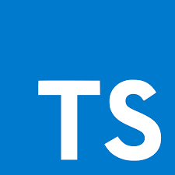
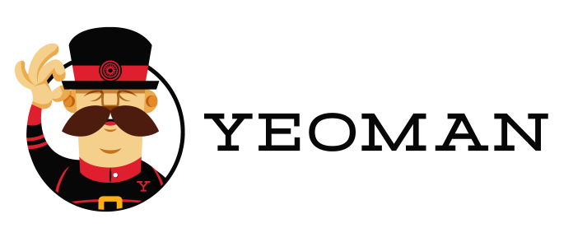

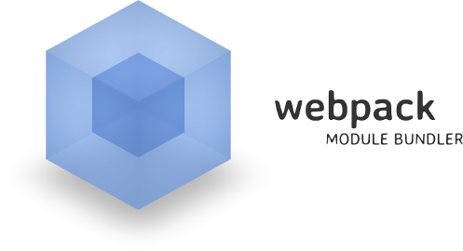
You NEED to know NPM and TypeScript
Must
Optional

Slide 24
Demo – Hello World
from the local Workbench
from the Cloud

Slide 25
Let’s Demo
Hello World Web Part (sastojci)
Yo
Gulp
Update TS
Go Live!

Slide 26
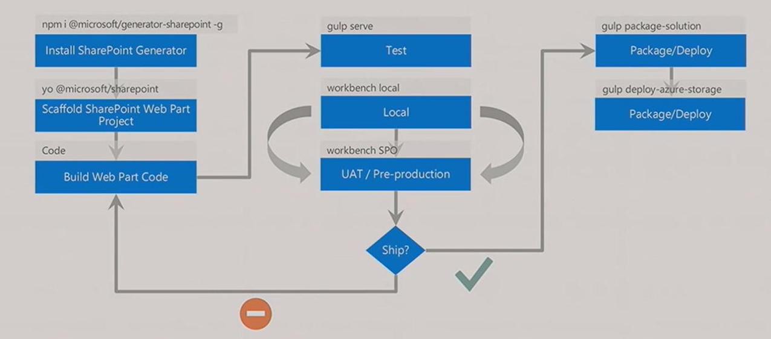
Client Side Web Part Flow

Slide 27
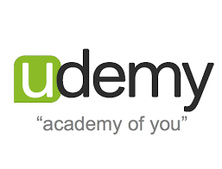



Preporuke za učenje
http://udemy.com
http://github.com
https://www.voitanos.io
https://dev.office.com/sharepoint

Slide 28
Hvala na pažnji!
Have a nice weekend!

